Slide 1

Book Recommendation system
Build a Recommendation With Collaborative Filtering

Slide 2
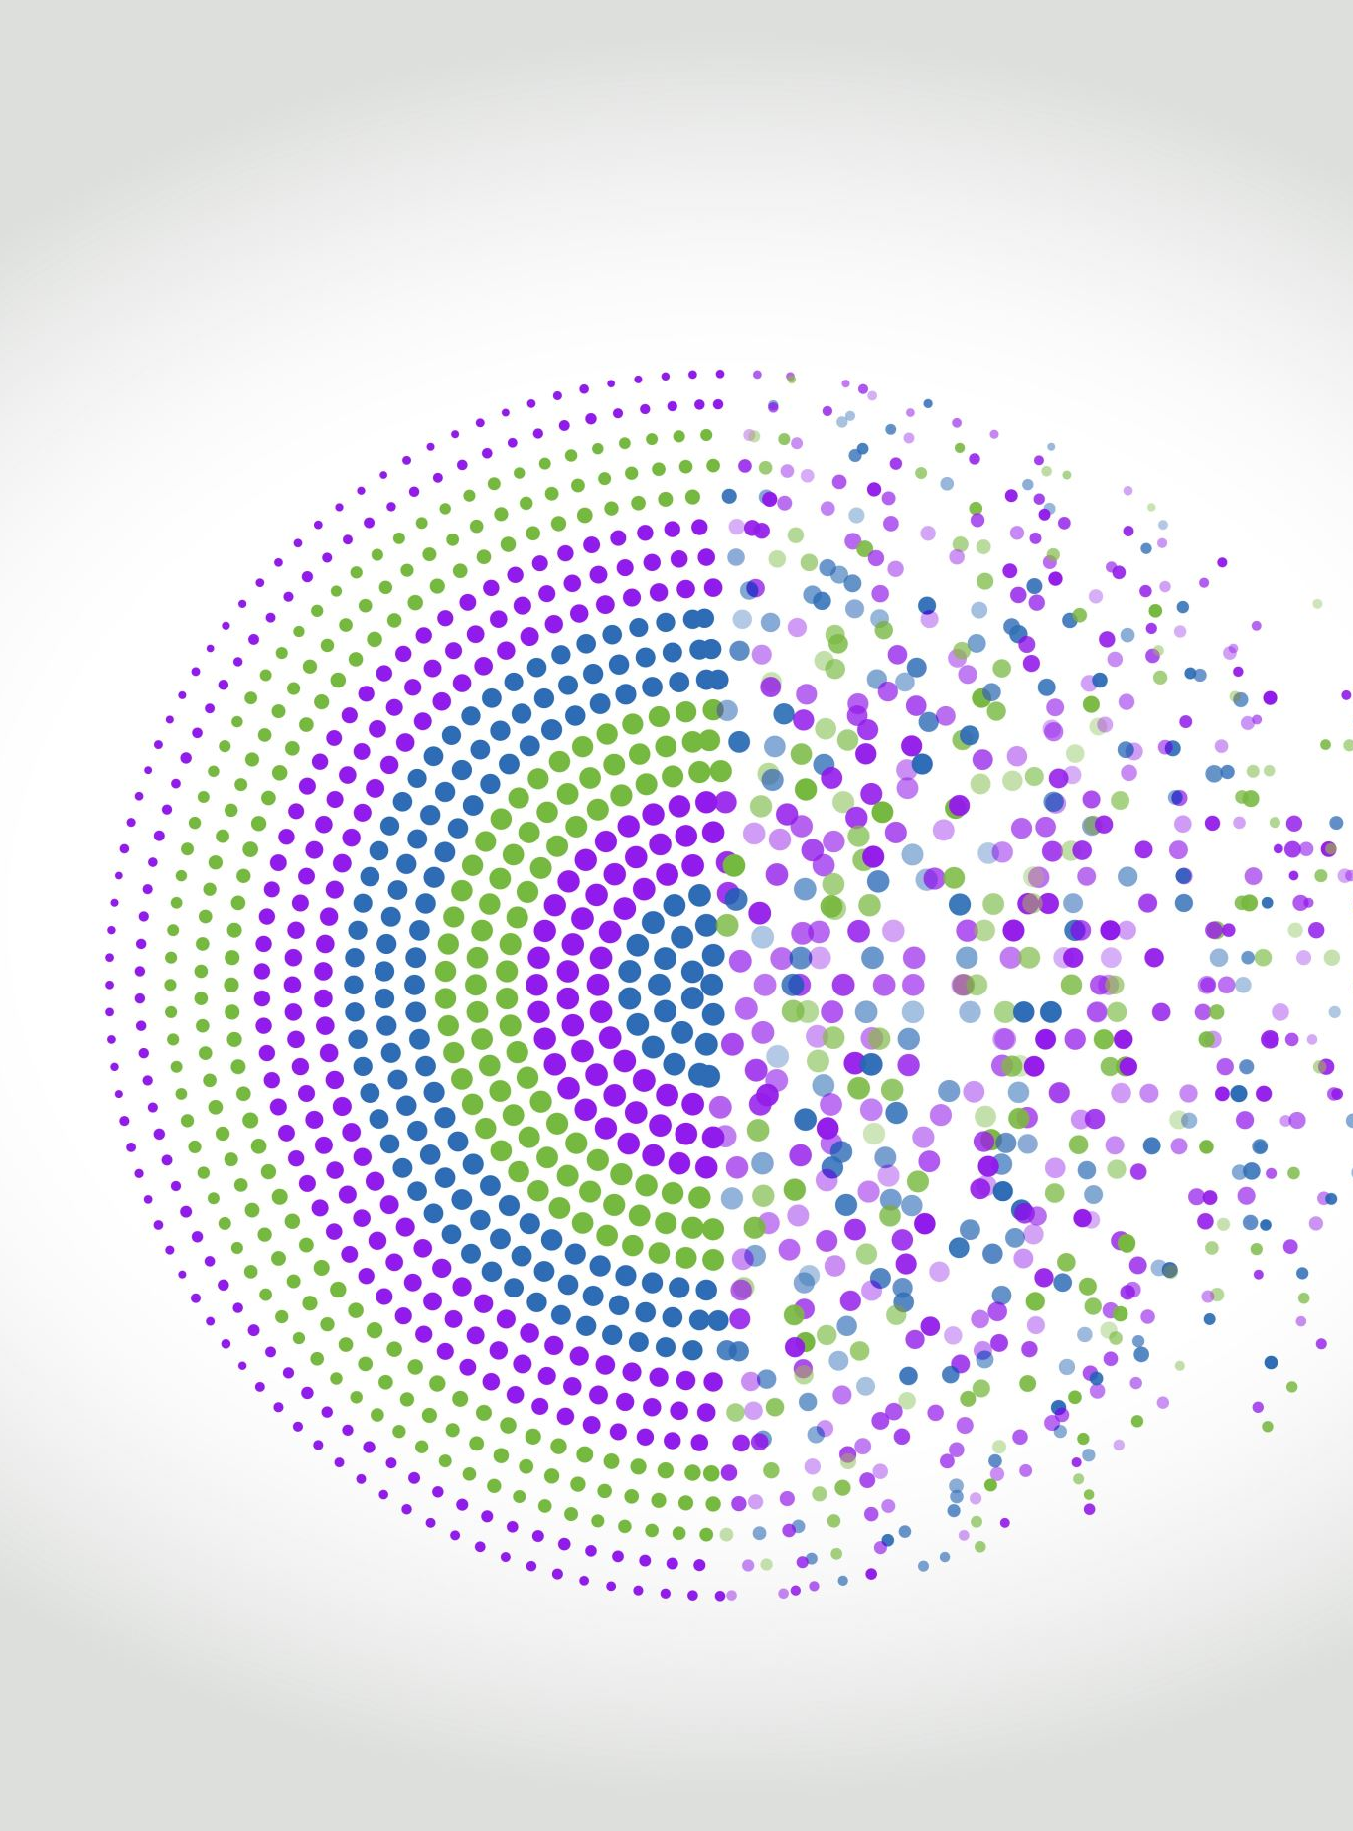
GROUP 3
TEAM MEMBERS
Ms. Olety Venkata Satya Sai Srija
Mr. Madhavarapu Siva Sai Ratan
Mr. Shaik Subhani
Ms. Kanthi Sameera Pantula
Ms. Biravelly Ravali
Mr. Bharath Thorlikonda
Mentor : Neha

Slide 3

Business Objective:
Generate the features from the dataset and use them to recommend the books accordingly to the users.

Slide 4

Introduction & Project Goal :
Exploring and Comparing different approaches to recommending the most relevant books to users based on their ratings with other books in the past based on other similar user’s interactions with books, and to recommend top 5 books based on the User ID as an input.

Slide 5

Content :
The Book-Crossing dataset comprises 3 files.
Users
user id unified identifier
location
age
Books
ISBN
Book title
Year of publication
publisher
Image-URL-Small
Image-URL-medium
Image-URL-large
Ratings
Book ratings
Demographic data
International standard book number
Content based information
URL links to the cover pages
1 to 10 (Explicit rating)
0 no rating given (Implicit rating)

Slide 6
Observation from the data :
Data was provided in 3 separate files , had to be merged based on ISBN and User ID before starting analysis.
Many null values in the age column of users .
Data contained random errors, like some publisher names were entered into Year of Publication column , and there were also 0s entered for Year of publication.
Location information was written as a long list of strings, was broken up into different columns containing city , state and country information for cleaner analysis.
Each file included lot of duplicated rows , All duplicates were removed before starting.

Slide 7
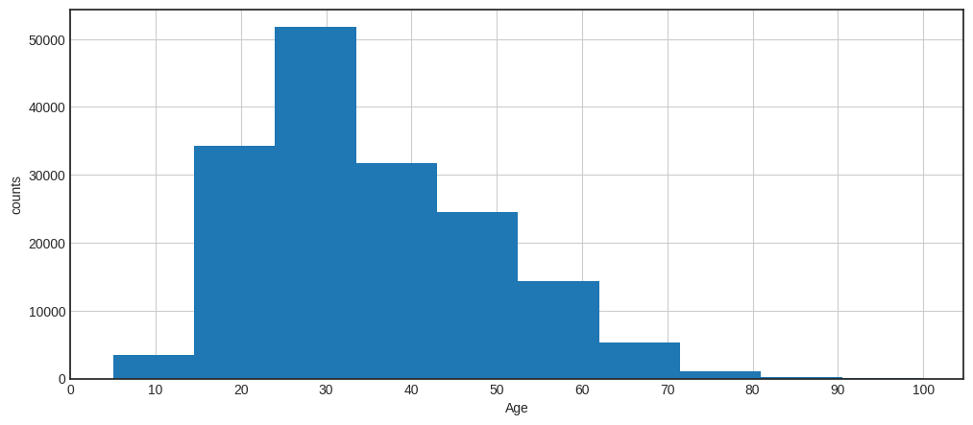
Histogram of Age
Data Exploration :

Slide 8
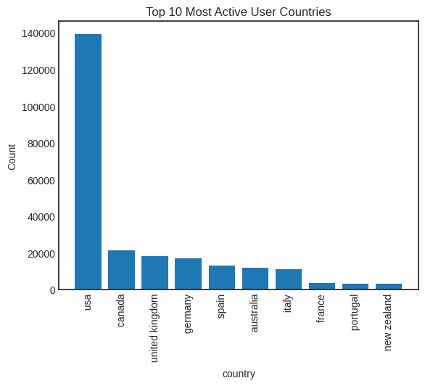
Top 10 most active user countries
Data Exploration :

Slide 9
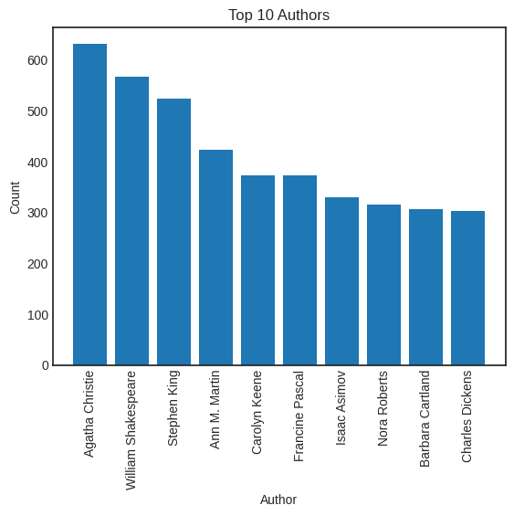
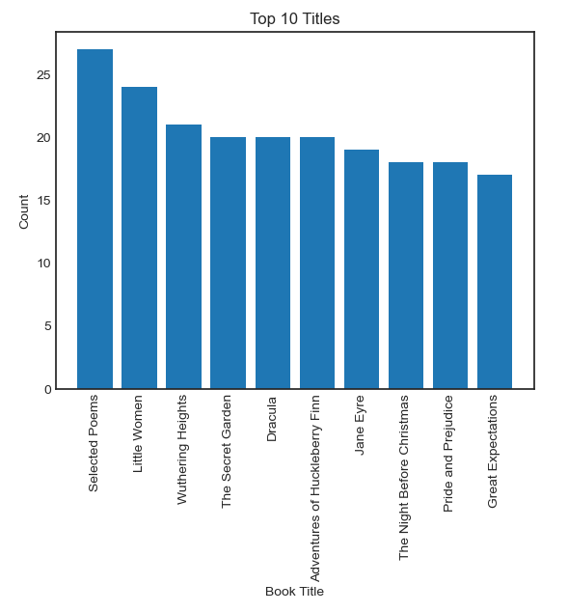
Data Exploration :
Top 10 authors
Top 10 titles

Slide 10
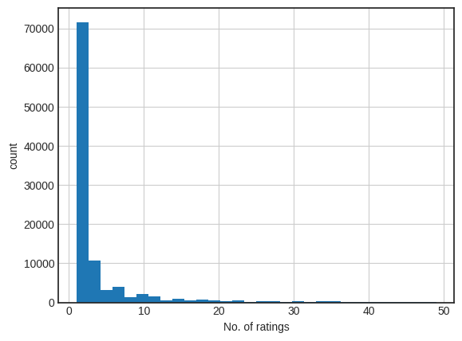
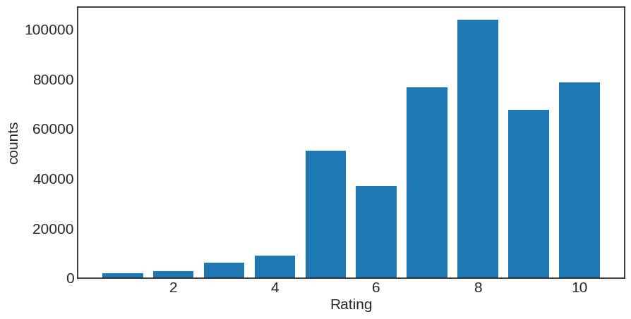
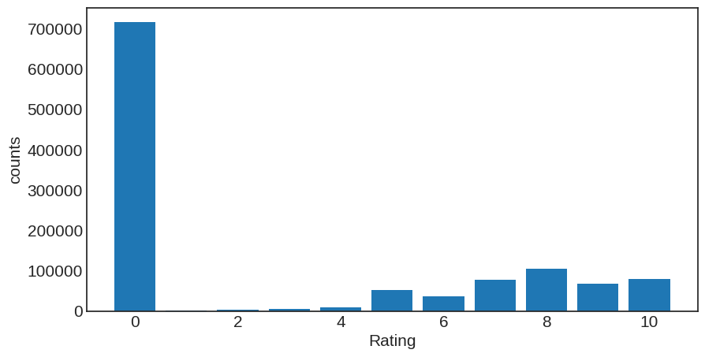
Data Exploration :
User
Rating
Books

Slide 11
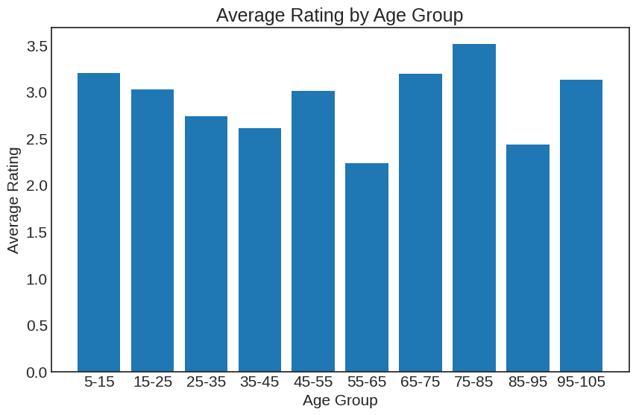
Average Rating
Data Exploration :

Slide 12
Recommendation Systems
It is an algorithm that suggests relevant items to users. Eg: In the case of Netflix which movie to watch, In the case of e-commerce which product to buy, or In the case of kindle which book to read, etc.
Use-Cases Of Recommendation System :
There are many use-cases of it. Some are
Personalized Content: Helps to Improve the on-site experience by creating dynamic recommendations
for different kinds of audiences like Netflix does.
Better Product search experience: Helps to categories the product based on their features. Eg: Material, Season, etc.
TYPES OF RECOMMENDATION SYSTEM :
1) Popularity Based Filtering
2) Collaborative Based Filtering

Slide 13
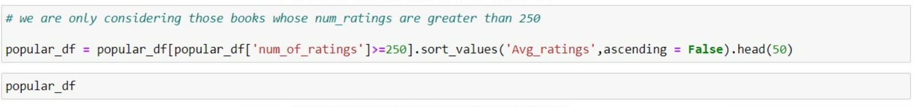
Popularity Based Filtering
Merged the 'books' and 'ratings' datasets based on the ISBN. Calculated the number of ratings and average ratings for each book. Filtered out books with fewer than 250 ratings. Dropped unnecessary columns from the 'merged_df' dataset.
Cleaned 'merged_df' by removing rows with missing values in 'age', 'country', and 'age_group'.Grouped 'merged_df' by book title, calculating the count and average ratings.
Created a 'popular_df' dataframe containing information about popular books.Implemented a function 'popularity_recommendation' that takes a user_id as input and suggests popular books based on the user's country and age group.Allowed user input to get recommendations for a specific user_id.
Provided top 5 book recommendations for a user based on average ratings.Displayed book titles, authors, and image URLs for user recommendations.

Slide 14
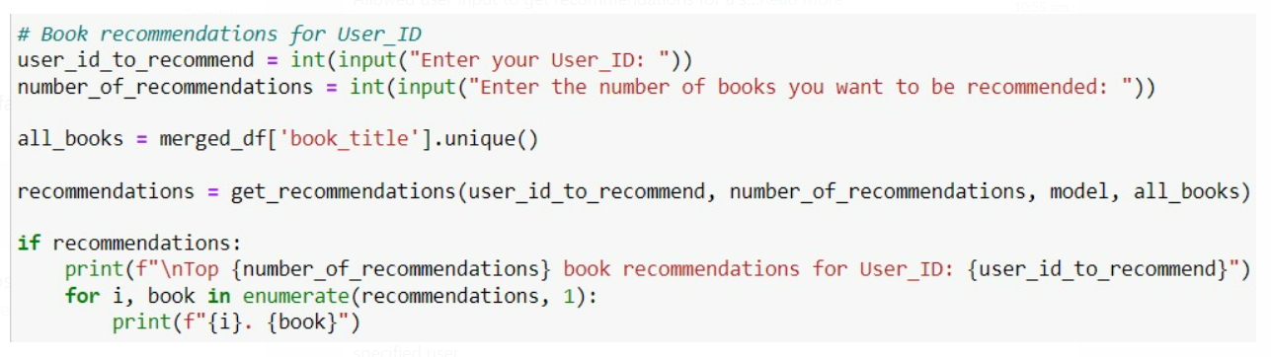
Collaborative Filtering
Utilized the Surprise library to implement a Collaborative Filtering model . The model is trained on the 'trainset' and tested on the 'testset' split from the dataset.
Created a function ‘get recommendations' to generate book recommendations for a given user
The function considers the unrated books for a user and predicts their ratings using the trained model.
Users can input their user_id and specify the number of book recommendations they want.
The model provides top-n book recommendations based on predicted ratings for the specified user . The recommendations are unique, excluding books already rated by the user.

Slide 15
User – Based Collaborative Filtering :
This technique used to predict the items that a user might like based on ratings given to that item by the other users who have similar tastes
The performance of the recommendations will keep improving as the size of the neighborhood grows.
It requires only user ratings to make recommendations, which is independent from user demographic features.
It tends to generate more diverse results because users have varied tastes

Slide 16
Deployment
Integration of Machine Learning Model into an existing production environment where the user can enter the input to generate output & later it can used in making business decisions.
In Python , we can achieve the same by using different frameworks
Django
Flask
Streamlit
We used streamlit for deployment.
Streamlit is a Python library that makes it easy to create web applications for data science and machine learning projects with minimal effort.

Slide 17
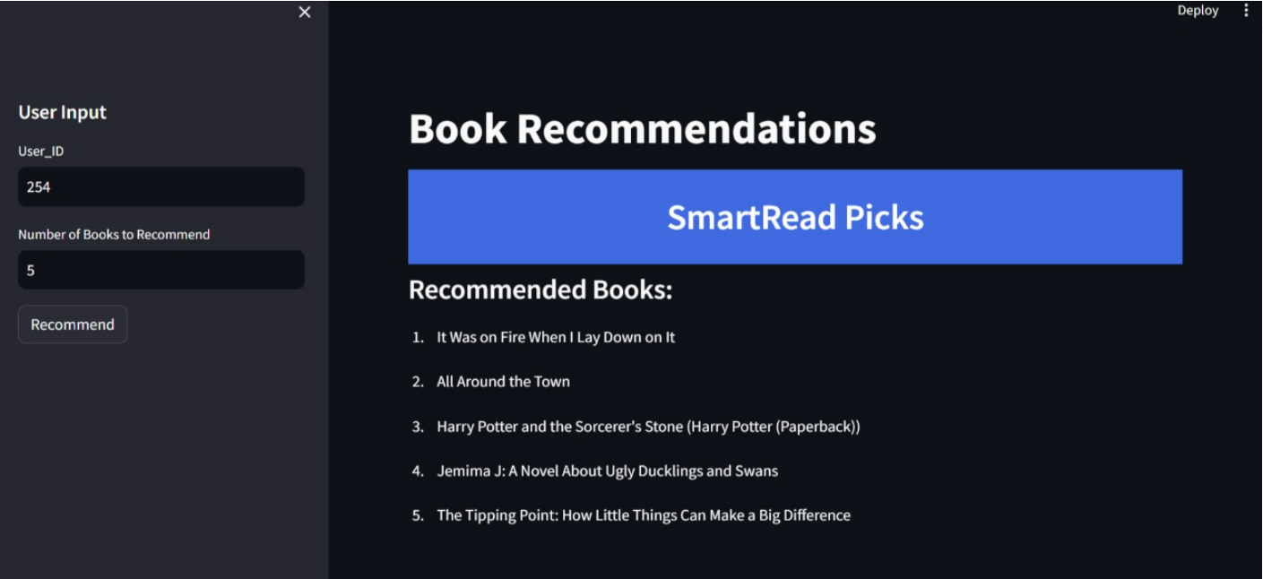

Slide 18
Conclusion
Help goodreaders to provide an improved customer experience and gain a competitive advantage.
Exploratory Data Analysis (EDA) and visualizations helped us gain insights into the distribution of user ages, the popularity of books, and the relationships between users and books.
Data preprocessing, feature engineering, and model evaluation were emphasized as important steps in building a successful book recommendation system.
The project provided valuable experience in working with real-world datasets, handling missing values, and building recommendation systems using various techniques.

Slide 19

Thank You !!!

